Slide 1


Department of Computer Science and Engineering
Advanced Deepfake Detection Using Temporal Segment Networks
LEENA SRI M P : 211421104141
JAYSHREE A : 211421104107
KETHSIA I : 211421104127
Dr. Kavitha Subramani Assistant Head Of Department(CSE)

Slide 2
Abstract
Deepfake technology creates realistic fake videos, increasing misinformation and security threats.
Current detection methods struggle with accuracy, especially in complex scenarios.
Integration of Temporal Segment Networks (TSNs) to analyze sequential frames.
2D face analysis using ResNet for spatial feature extraction.
PWC-Net for motion estimation, capturing subtle inconsistencies in facial movements.
LSTM-based temporal analysis to detect inconsistencies over time.
Attention mechanisms focus on key facial regions prone to manipulation.
Ensemble learning techniques combine multiple models for improved robustness.
Decision-level fusion integrates multiple feature-based predictions for higher accuracy.

Slide 3
Introduction
Rapid advancement of AI has revolutionized media creation through deepfake technology.
Generative Adversarial Networks (GANs) enable the creation of highly realistic but fake audio and video content.
Creative and educational fields benefit from deepfake applications in films and learning tools.
Malicious use poses threats to national security, privacy, and public trust.
Political manipulation through deepfakes was a concern during the 2020 U.S. elections.
Online harassment and defamation have increased with fake videos targeting individuals.
Financial losses and reputational damage affect both organizations and individuals.
False information spreads easily through realistic but deceptive media.
Detection challenges arise as deepfakes become increasingly sophisticated.

Slide 4
Objective of the Project
To develop a system that can detect whether the videos on societal websites are fake
or not.
To develop a system that leverages motion estimation and attention mechanisms to detect manipulated regions in videos.
To develop a system that accurately identifies deepfake videos by analyzing spatial and temporal inconsistencies.
To develop a system that integrates ensemble learning techniques to improve detection accuracy and robustness.

Slide 5
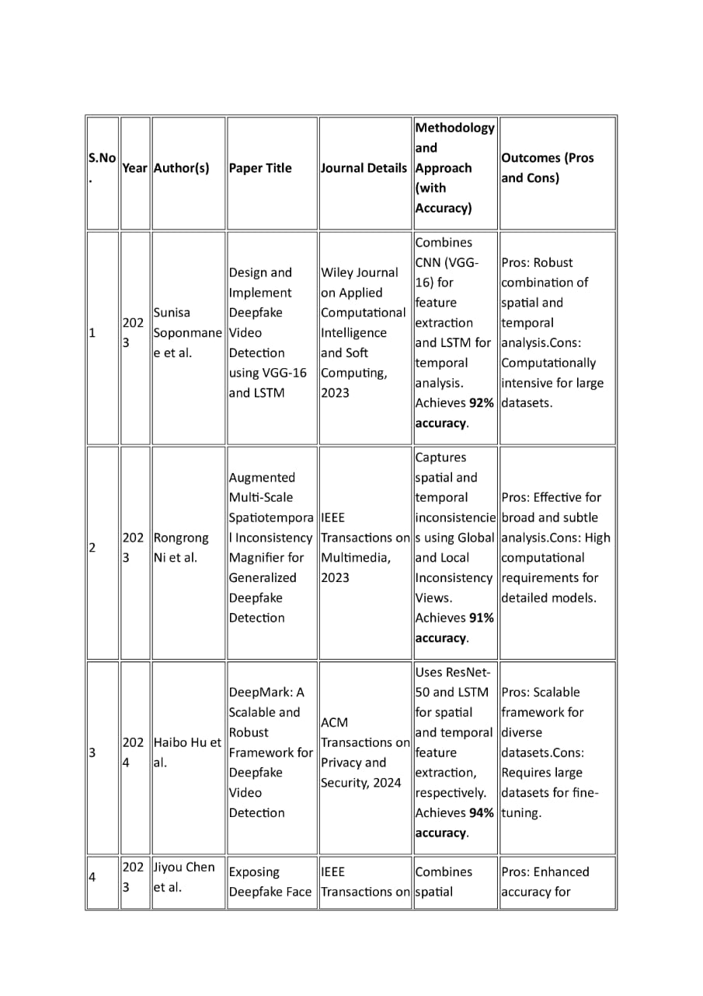
Literature Survey

Slide 6
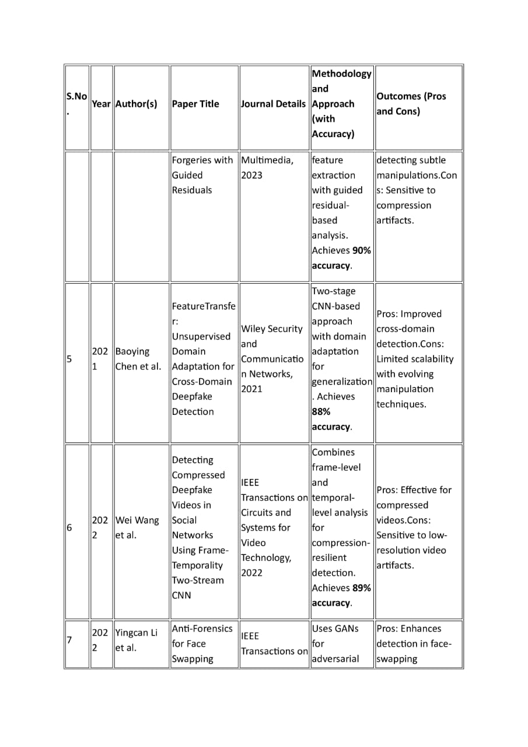
Literature Survey

Slide 7
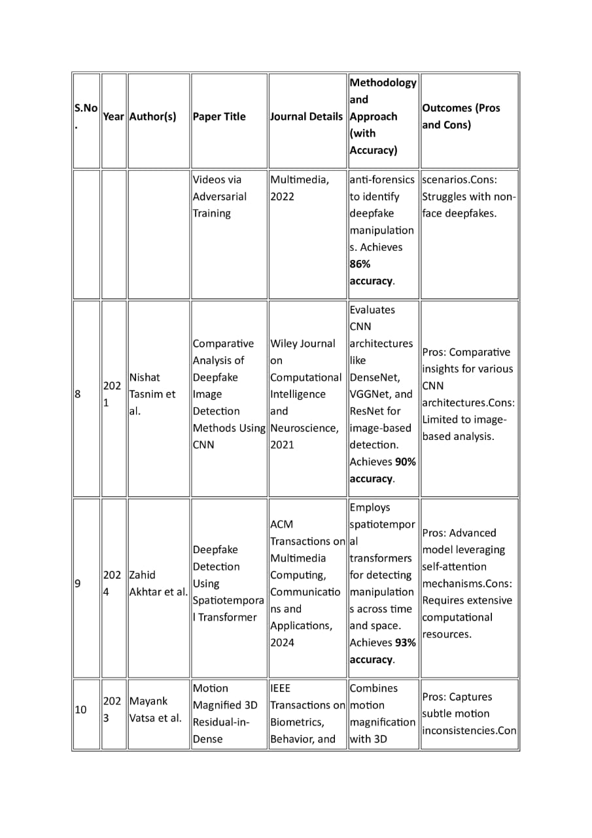
Literature Survey

Slide 8
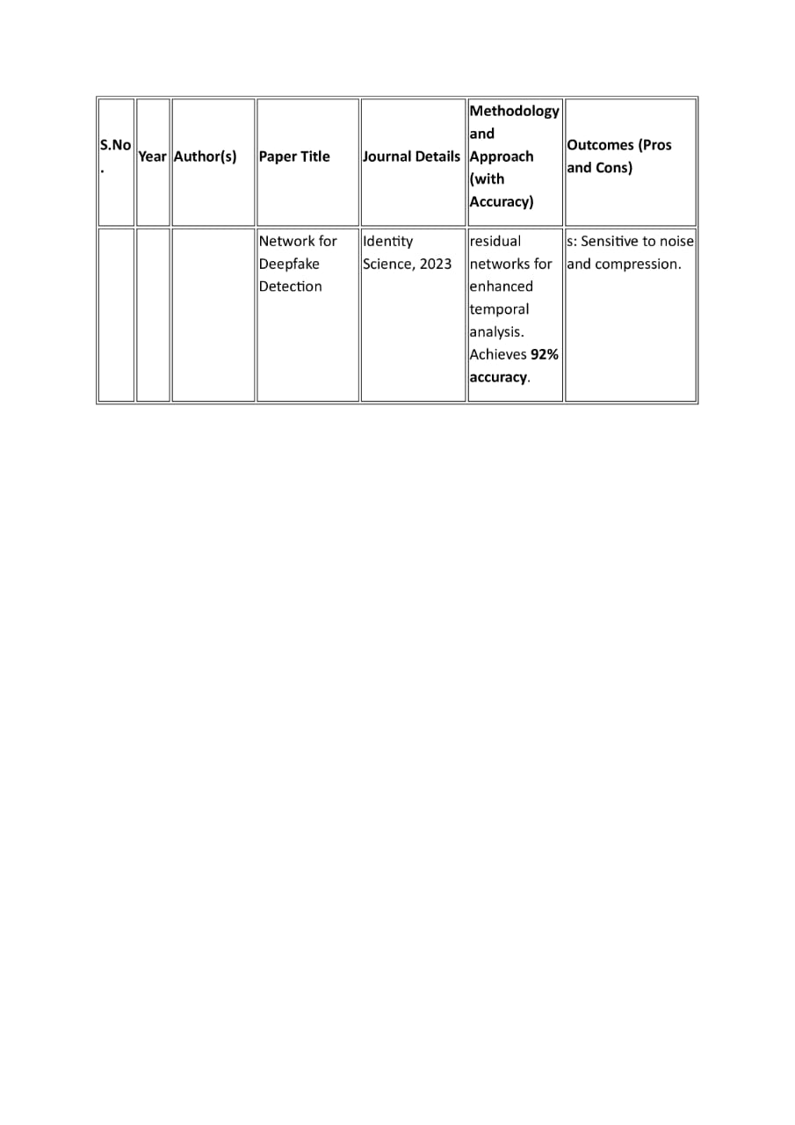
Literature Survey

Slide 9
Problem Statement
The rise of deepfake technology has led to highly realistic fake videos, posing serious threats to digital security and spreading misinformation. Existing detection methods often struggle to handle the complexity of modern deepfakes. This research aims to develop an advanced detection system by leveraging Temporal Segment Networks (TSNs), motion estimation techniques, and attention mechanisms. Additionally, it will incorporate spatial and temporal analysis to detect inconsistencies and manipulated regions in videos, ensuring improved accuracy and robustness even in challenging scenarios

Slide 10
Proposed System
The proposed system processes video data to detect deepfakes by leveraging 2D facial feature analysis.
Video Upload and Preprocessing: The video is uploaded and then preprocessed to extract frames, detect faces, and align them. This ensures the data is in a consistent format for further processing.
Loading Processed Video and Labels: The processed video (which contains only the face) and associated labels (real or fake) are loaded into the system for feature extraction and classification.
Feature Extraction:
The ResNet architecture is used for spatial feature extraction from the 2D video frames.
LSTM architecture is used for temporal feature extraction.
Video Classification Using LSTM: Long Short-Term Memory (LSTM) networks are employed to classify the video based on the temporal sequence of frames. LSTMs are well-suited for handling time-series data like video frames.
Model Outputs and Decision-Level Fusion: The spatial and temporal outputs are combined at a decision level to make a final determination. This fusion process enhances the accuracy by considering both the spatial and temporal features.

Slide 11
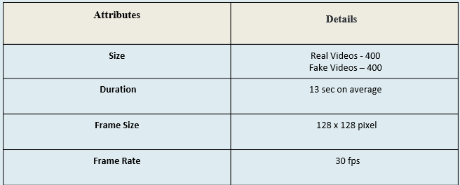
DATASET
CELEBDF

Slide 12
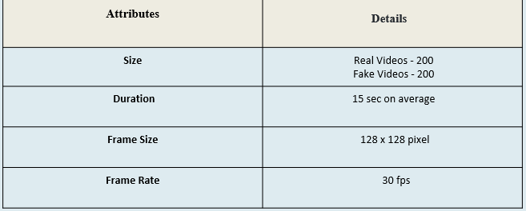
DATASET
FACE FORENSIC++ :

Slide 13
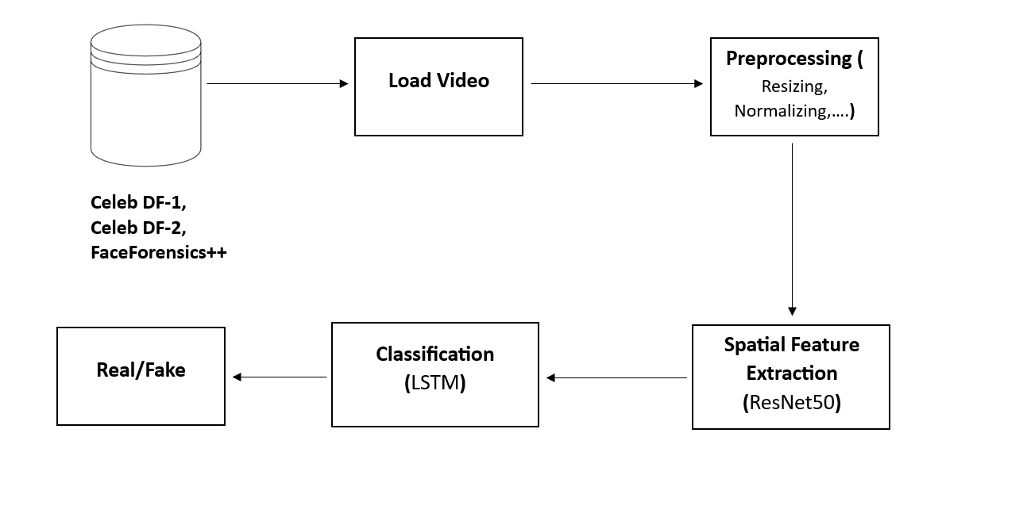
System Design - Flow Chart/DFD/ER

Slide 14
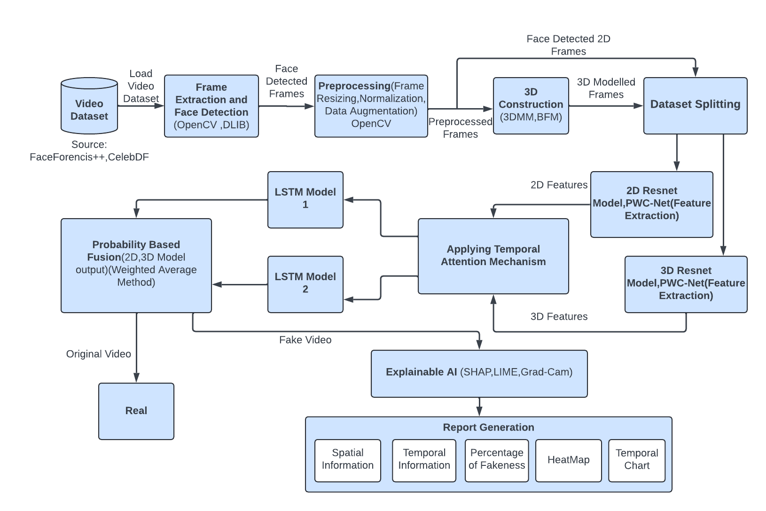
Architecture / Methodology used

Slide 15
Data Processing
Input: Video Dataset
Step 1: Import the required video dataset
Extract frames from the video
Step 2: Identify the frames which has face
Remove frames without face
Step 3: Using the face alignment techniques align the face in the image
Return the processed image
Step 4: Resize the processed frames
Output: Processed Frames

Slide 16
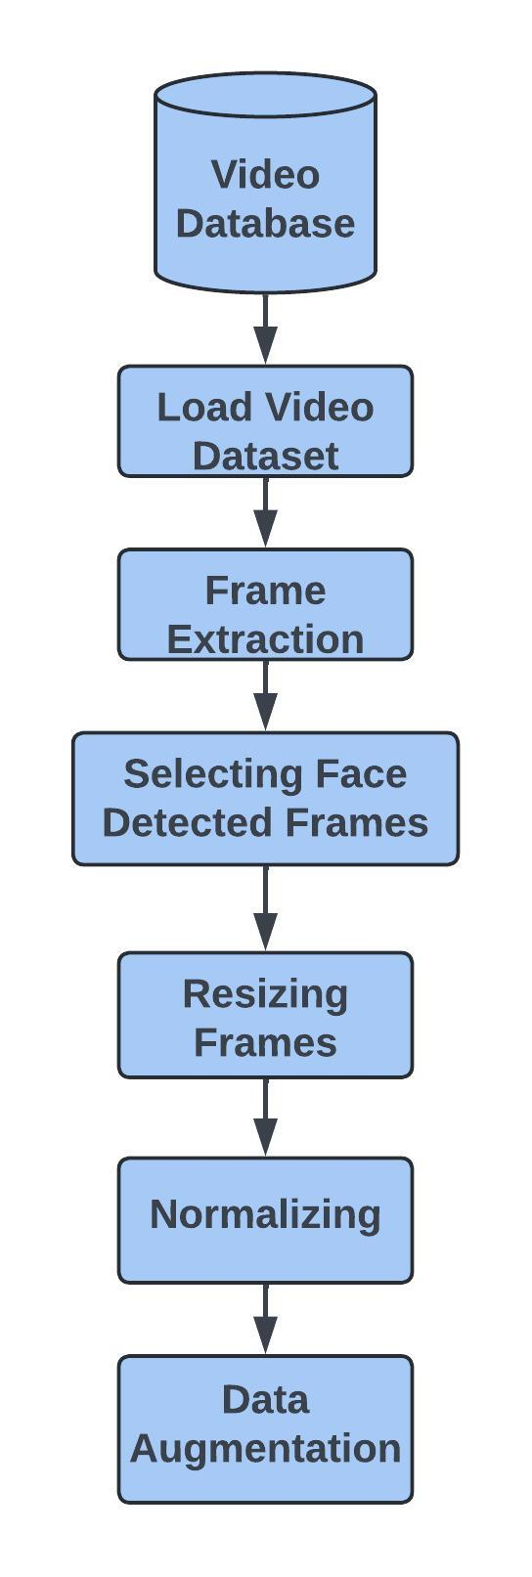
System Design – Data Processing Pipeline

Slide 17
Video frame Extraction and processing
The table consist of frame extraction process applied on video dataset.
The table consist of total number of frames in a video, frames which have space and then it is preprocessed to work with evenly spaced frames to enhance the accuracy of deepfake detection.
The video dataset of Celeb-DF and Faceforensics++ are used where frame extraction process of 10 sample videos are shown here.
Frames are evenly spaced which help in preserving key temporal information, making it an effective approach for analyzing videos in tasks such as deepfake detection.

Slide 18
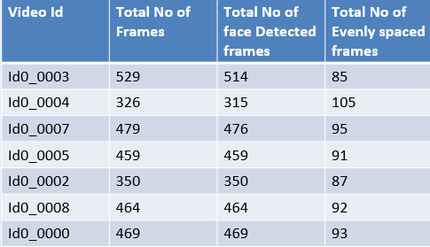
Video frame Extraction and Processing

Slide 19
Module Description
1. PWC-NET:
Purpose : Motion estimation between two frames by computing optical flow Implementation: PWC-Net to compute optical flow between frame pairs, extracting motion vectors. Detection: Extracted flow fields detect abnormal motion patterns Output: Optical flow features representing frame-to-frame motion. 2. Long Short Term Memory:
Purpose: Capture temporal relationships across sequential frames Implementation: Passed sequence of feature vectors into LSTM layers to capture time dependencies. LSTM processes the sequence of feature vectors Output: Temporal feature map that captures the sequence of spatial features across the frames

Slide 20
Module Description
3. Decision Making:
Purpose: Combine outputs LSTM Model for more accurate deepfake classification.
Implementation: Performed decision fusion using weighted average or concatenation methods to integrate spatial, temporal, and motion features.Implemented a final decision-making layer (softmax) to classify videos as real or deepfake.
Output: A final classification decision based on the fused feature vectors.

Slide 21
Spatial Feature Extraction
Input:
Data: Preprocessed video frames in image format (e.g., .jpg, .png, .jpeg).
Frame Size: Each image is resized to 128x128 pixels.
2. Image Preprocessing:
Load Image:
Read the image from the specified path.
Convert the image to RGB format if it is not already.
Transform Image:
Convert the image to a tensor using transforms.ToTensor().
Norrmalize the tensor using the mean and standard deviation specific to ResNet-50:
Mean: [0.485, 0.456, 0.406]
Std: [0.229, 0.224, 0.225]
Add a batch dimension to the tensor to shape it as [1, 3, 128, 128].

Slide 22
Spatial Feature Extraction
3. Feature Extraction:
Forward Pass through ResNet-50:
Pass the preprocessed image tensor through the ResNet-50 model.
Since the final classification layer is removed, obtain the output from the last residual block (average pooling layer).
Extract Features:
The output of ResNet-50 (after removing the classification layer) is a 2048-dimensional feature vector for each image.
4. Output:
Features:
Shape: The output feature vector is of shape [2048] for each image.
Format: Features are stored as a NumPy array or tensor.

Slide 23
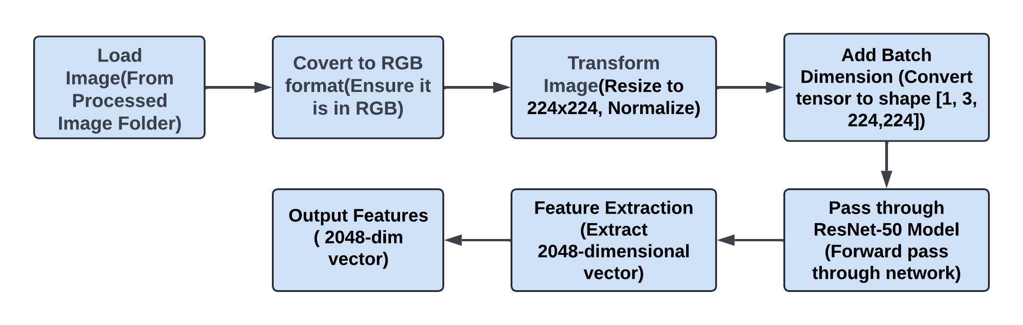
ResNet Feature Extraction Pipeline

Slide 24
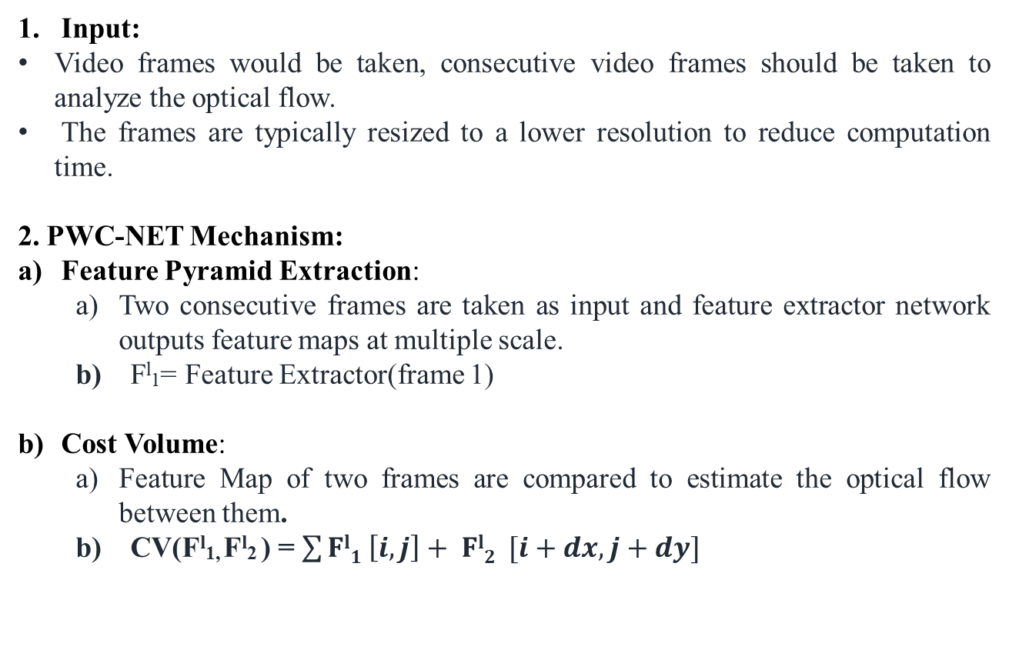
Optical Motion Analysis
Input:
Video frames would be taken, consecutive video frames should be taken to analyze the optical flow.
The frames are typically resized to a lower resolution to reduce computation time.
2. PWC-NET Mechanism:
Feature Pyramid Extraction:
Two consecutive frames are taken as input and feature extractor network outputs feature maps at multiple scale.
b) F^{l}₁= Feature Extractor(frame 1)
Cost Volume:
Feature Map of two frames are compared to estimate the optical flow between them.
b) CV(F^{l}_{1,} F^{l}₂ ) = $\sum{Fl1 \left[i, j\right]+ Fl2 [i+dx, j+dy]}$

Slide 25
Optical Motion Analysis
2. PWC-NET Mechanism:
Optical Flow Estimation:
Current optical flow refined by passing through convolutional layers that consider both feature map and cost volume.
Flow^{l} = Optical Flow Estimator(CV(F^{l}_{1,} F^{l}₂ ), Flow ^{l+1})
Output:PWC-NET produce a dense optical flow between two frames which is a tensor of shape [batch_size, 2, H, W], where H and W are height and width of the frames.

Slide 26
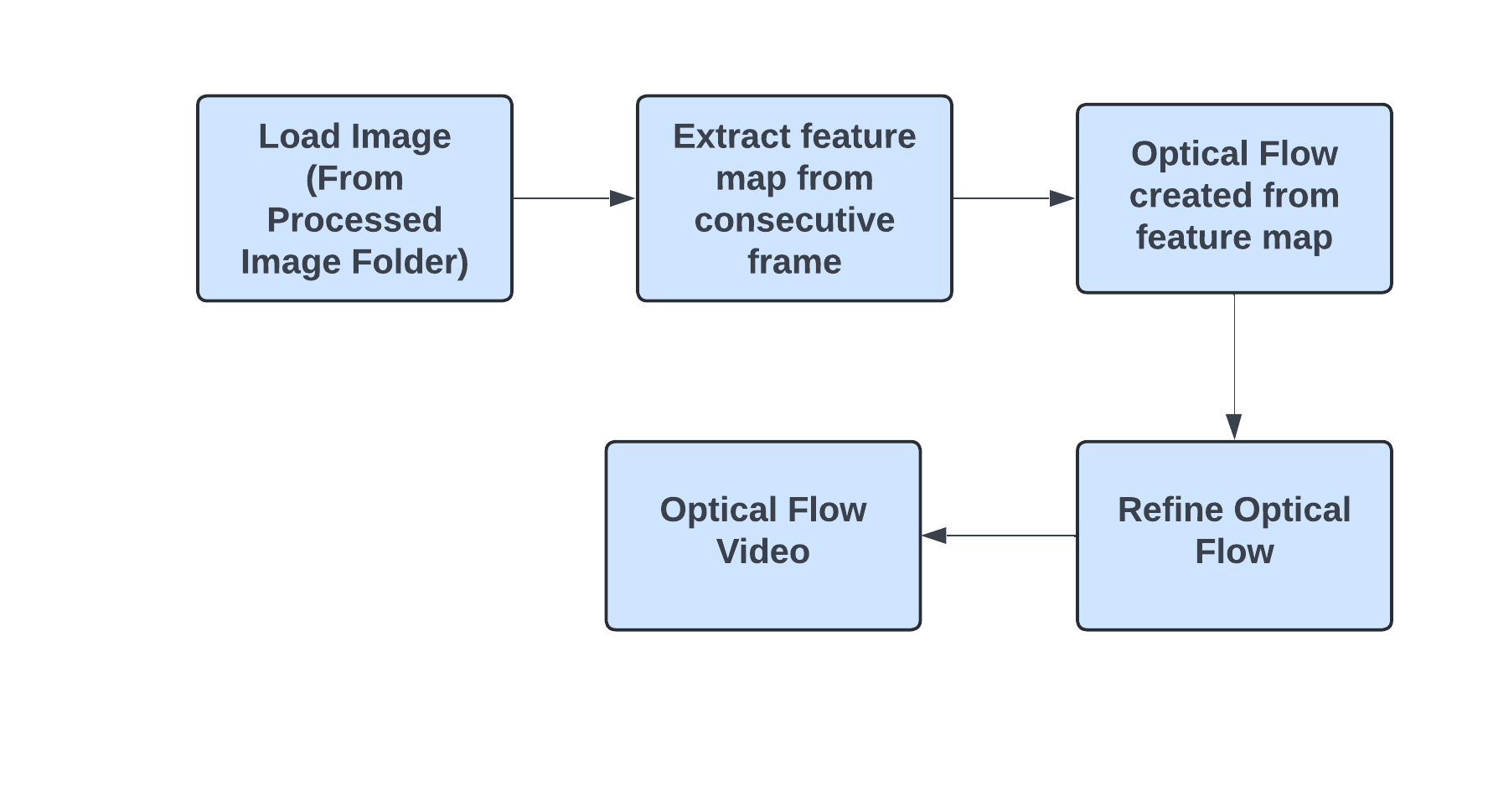
PWC-NET PIPELINE

Slide 27
Temporal Feature Extraction
Input:
Vector: ResNet Feature Vector. Each input vector in the sequence has a fixed size, which could be the number of features per time step.
LSTM input requirements, yielding a tensor of shape [batch_size, seq_length, latent_dim] where latent_dim=2048.
2. Gate Mechanism:
Forget Gate:
The forget gate determines what portion of the previous cell state should be "forgotten" or removed.
b) f_{t​} = σ(W_{f}​ ⋅[h_{t−1}​ ,x_{t}​ ]+b_{f} )
Input Gate:
The input gate controls how much of the new information (from the current input) should be stored in the cell state.
b) i_{t​} = σ(W_{i} ⋅[h_{i−1}​ ,x_{t}​ ]+b_{i} )

Slide 28
Temporal Feature Extraction
2. Gate Mechanism:
Output Gate:
The output gate determines the hidden state at the current time step, which serves as the output of the LSTM for that time step.
o_{t​} = σ(W_{o} ⋅[h_{t−1}​ ,x_{t}​ ]+b_{o} )
Hidden State h_{t ​} = o_{t} ⋅ tanh(C_{t})
Output:The LSTM outputs the final hidden state from the last time step. The output of the model is a tensor of shape [batch_size, num_classes], where each entry represents the classification prediction for a sequence of video frames.

Slide 29
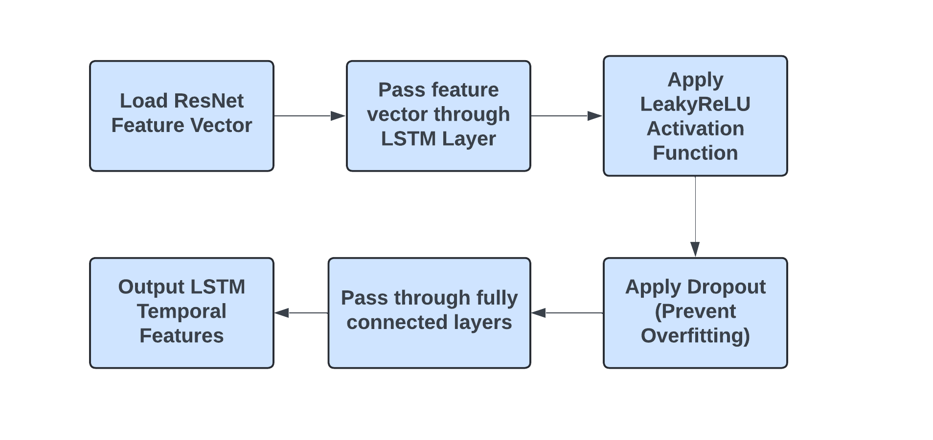
LSTM Feature Extraction Pipeline

Slide 30
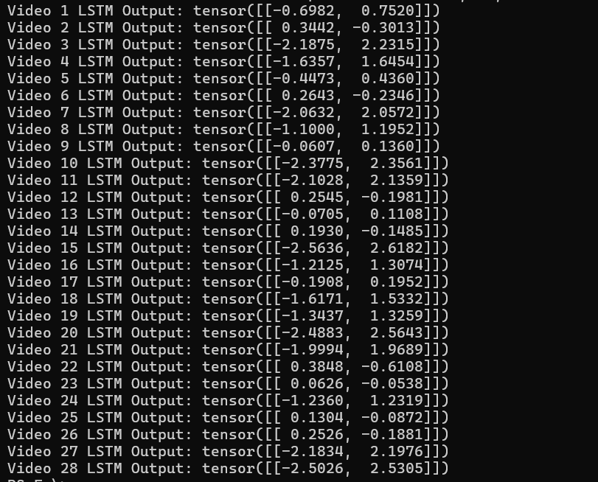
LSTM Vector

Slide 31
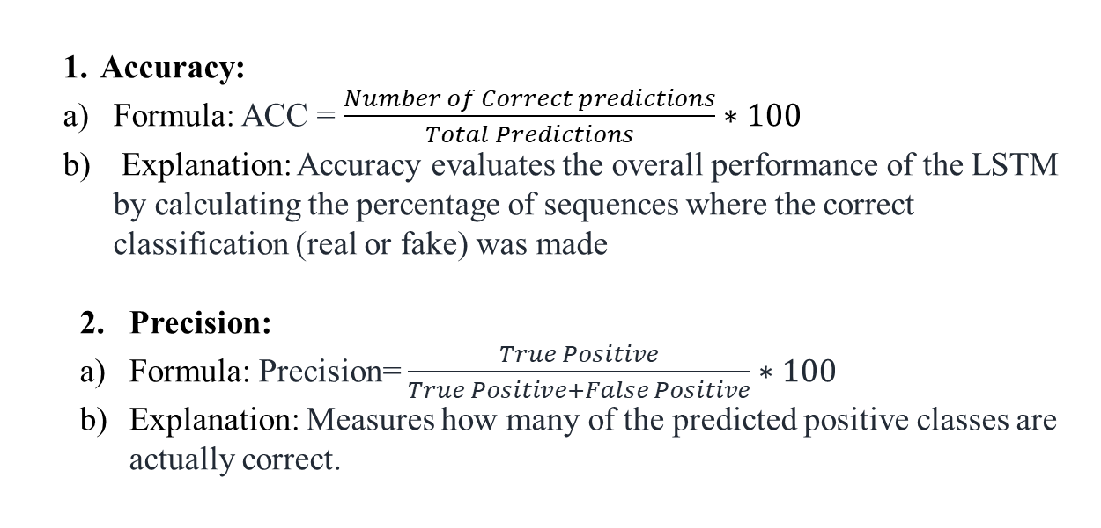
Result – Evaluation Metrics
Accuracy:
Formula: ACC = $\frac{Number of Correct predictions}{Total Predictions}∗100$
Explanation: Accuracy evaluates the overall performance of the LSTM by calculating the percentage of sequences where the correct classification (real or fake) was made
Precision:
Formula: Precision= $\frac{True Positive}{True Positive+False Positive}∗100$
Explanation: Measures how many of the predicted positive classes are actually correct.

Slide 32
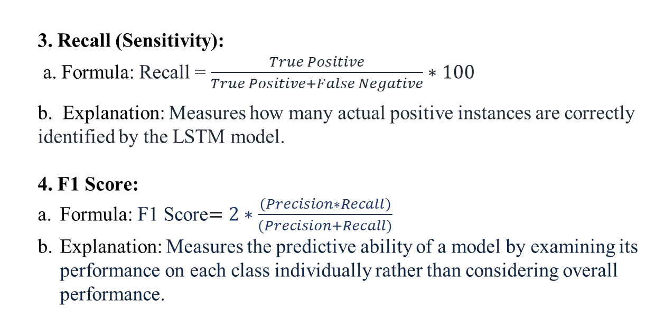
Result – Evaluation Metrics
3. Recall (Sensitivity):
a. Formula: Recall = $\frac{True Positive}{True Positive+False Negative}∗100$
b. Explanation: Measures how many actual positive instances are correctly identified by the LSTM model.
4. F1 Score:
Formula: F1 Score$=2∗\frac{\left(Precision∗Recall\right)}{(Precision+Recall)}$
Explanation: Measures the predictive ability of a model by examining its performance on each class individually rather than considering overall performance.

Slide 33
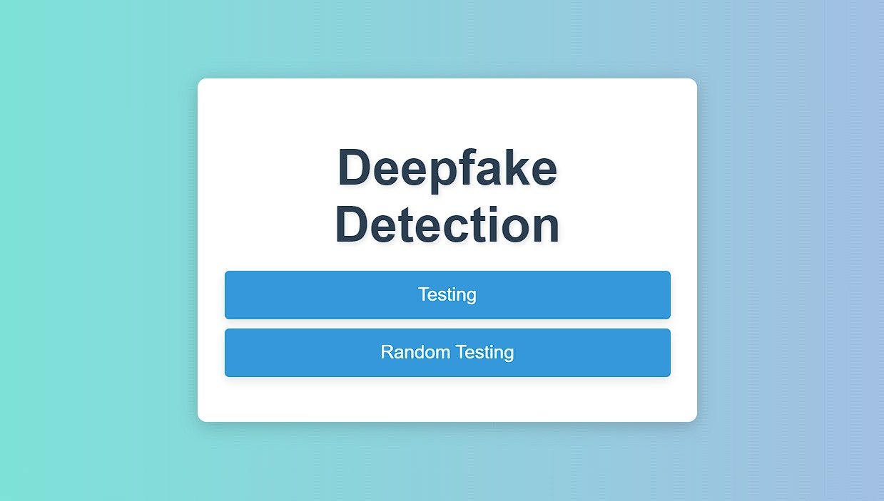
Screen Shots

Slide 34
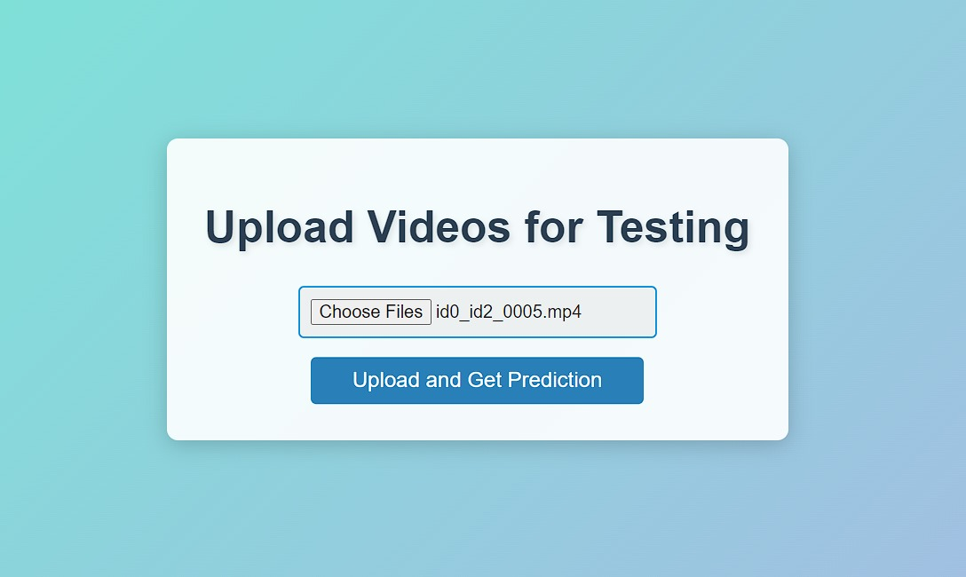
Screen Shots

Slide 35
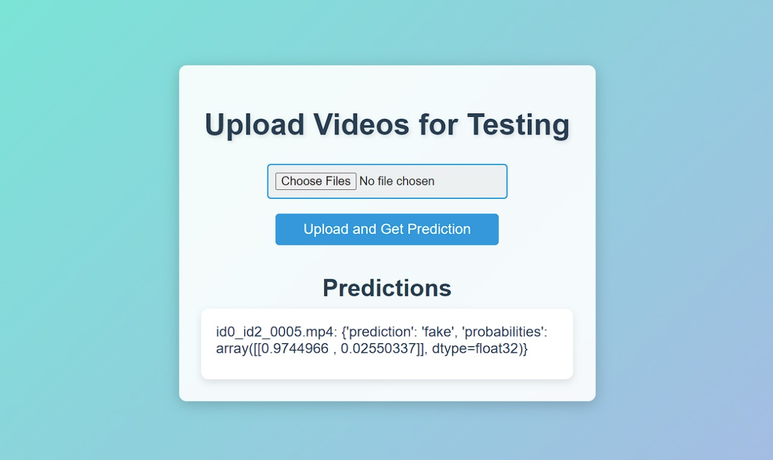
Screen Shots

Slide 36
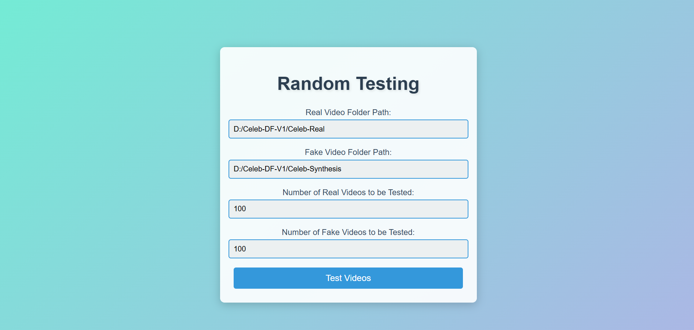
Screen Shots

Slide 37
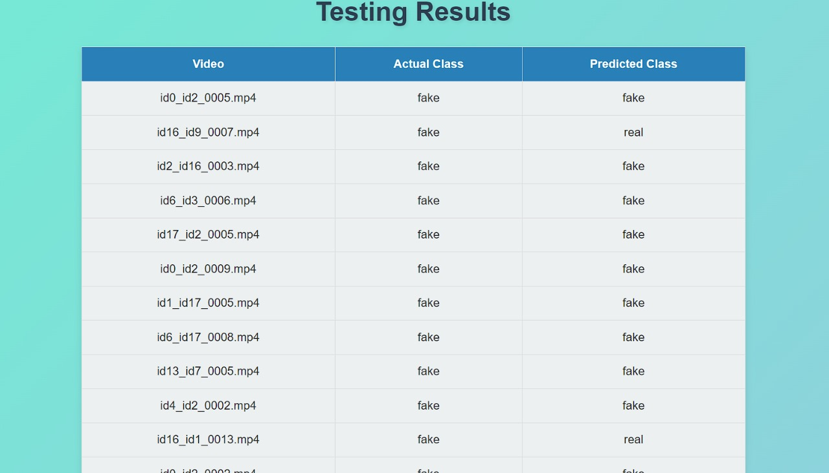
Screen Shots

Slide 38

Screen Shots

Slide 39

Screen Shots

Slide 40
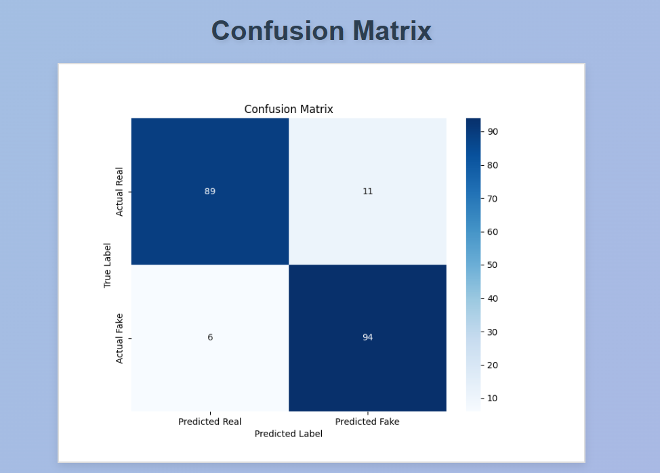
Screen Shots

Slide 41
Conclusion / Feature Enhancement
Deepfake technology poses significant threats to digital security and misinformation.
The proposed detection system integrates advanced machine learning and deep learning techniques for enhanced accuracy.
Combining spatial and temporal analysis improves the detection of deepfake patterns.
The system utilizes decision-level fusion to minimize false positives and negatives, ensuring reliability.
Robust training on diverse datasets strengthens performance across various scenarios.
Real-time detection capability is essential for practical deployment.
The system provides an interactive dashboard for user engagement and insights.
Continuous evolution is needed to address emerging deepfake techniques.

Slide 42
Conclusion / Feature Enhancement
Develop adaptive systems to counter rapidly evolving deepfake technology.
Minimize false positives and false negatives for higher reliability.
Create generalized models for detecting deepfakes across multiple media types.
Enhance scalability and real-time detection for high-throughput environments.
Improve model interpretability for better trust and transparency.
Expand diverse datasets and explore semi/unsupervised learning to reduce manual labeling.
Develop resilience against adversarial attacks to ensure robustness.
Address legal and ethical concerns regarding privacy and liability

Slide 43
Reference Paper/ URL
ImageNet Classification with Deep Convolutional Neural Networks
Generative Adversarial Nets (GANs)
BERT: Pre-training of Deep Bidirectional Transformers for Language Understanding
R-CNN: Region-Based Convolutional Networks for Object Detection
Deep Residual Learning for Image Recognition (ResNet)
You Only Look Once: Unified, Real-Time Object Detection (YOLO)
AlphaGo: Mastering the Game of Go with Deep Neural Networks
DeepFace: Closing the Gap to Human-Level Performance in Face Verification
VGGNet: Very Deep Convolutional Networks for Large-Scale Image Recognition
AlexNet: ImageNet Classification with Deep Convolutional Neural Networks
GPT-3: Language Models are Few-Shot Learners""Auto-Encoding Variational Bayes (VAE)
Dropout: A Simple Way to Prevent Neural Networks from Overfitting""Neural Machine

Slide 44
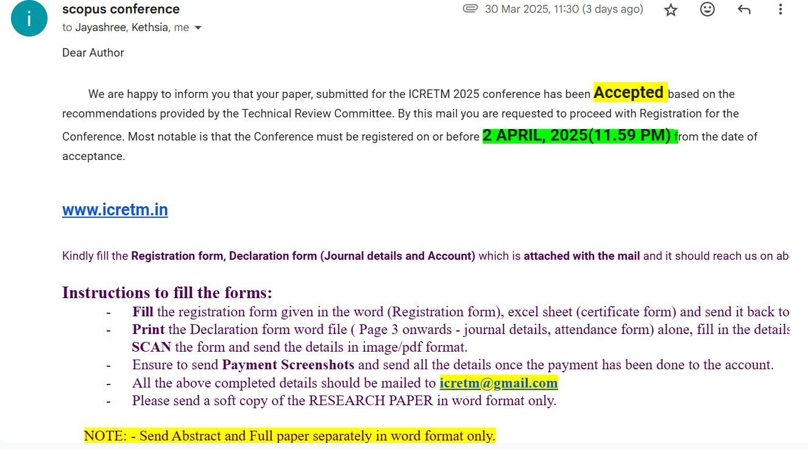
Conference / Publication / Patent Certificate/ Project Contest Winner Certificates

